Slide 1
New Approach to Teaching Evaluation
Annette Caldwell Simmons School of Education and Human Development
Department of Teaching & Learning
Department of Education Policy & Leadership

Slide 3
18. How much more deeply do you think about the content now?
19. How much more motivated are you to pursue learning in this area?
20. To what extent did you share what you learned with your friends?
21. To what extent did taking this particular class from this particular professor
impact your personal or professional trajectory?

Slide 4
Evaluator
Person
Expert
Facilitator

Slide 8
Pilot phase: Exploring options, generating ownership, ensuring meaningfulness
Implementation phase: confronting the advantages and disadvantages of moving beyond documentation toward use as an assessment tool

Slide 9
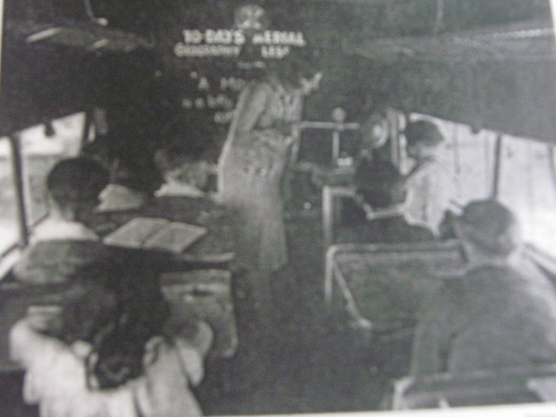
Cuban, L. (1993). How teachers taught: Constancy and change in American classrooms. New York: Teachers College Press.

